Slide 1
Computer Vision
AI for Business

Slide 2
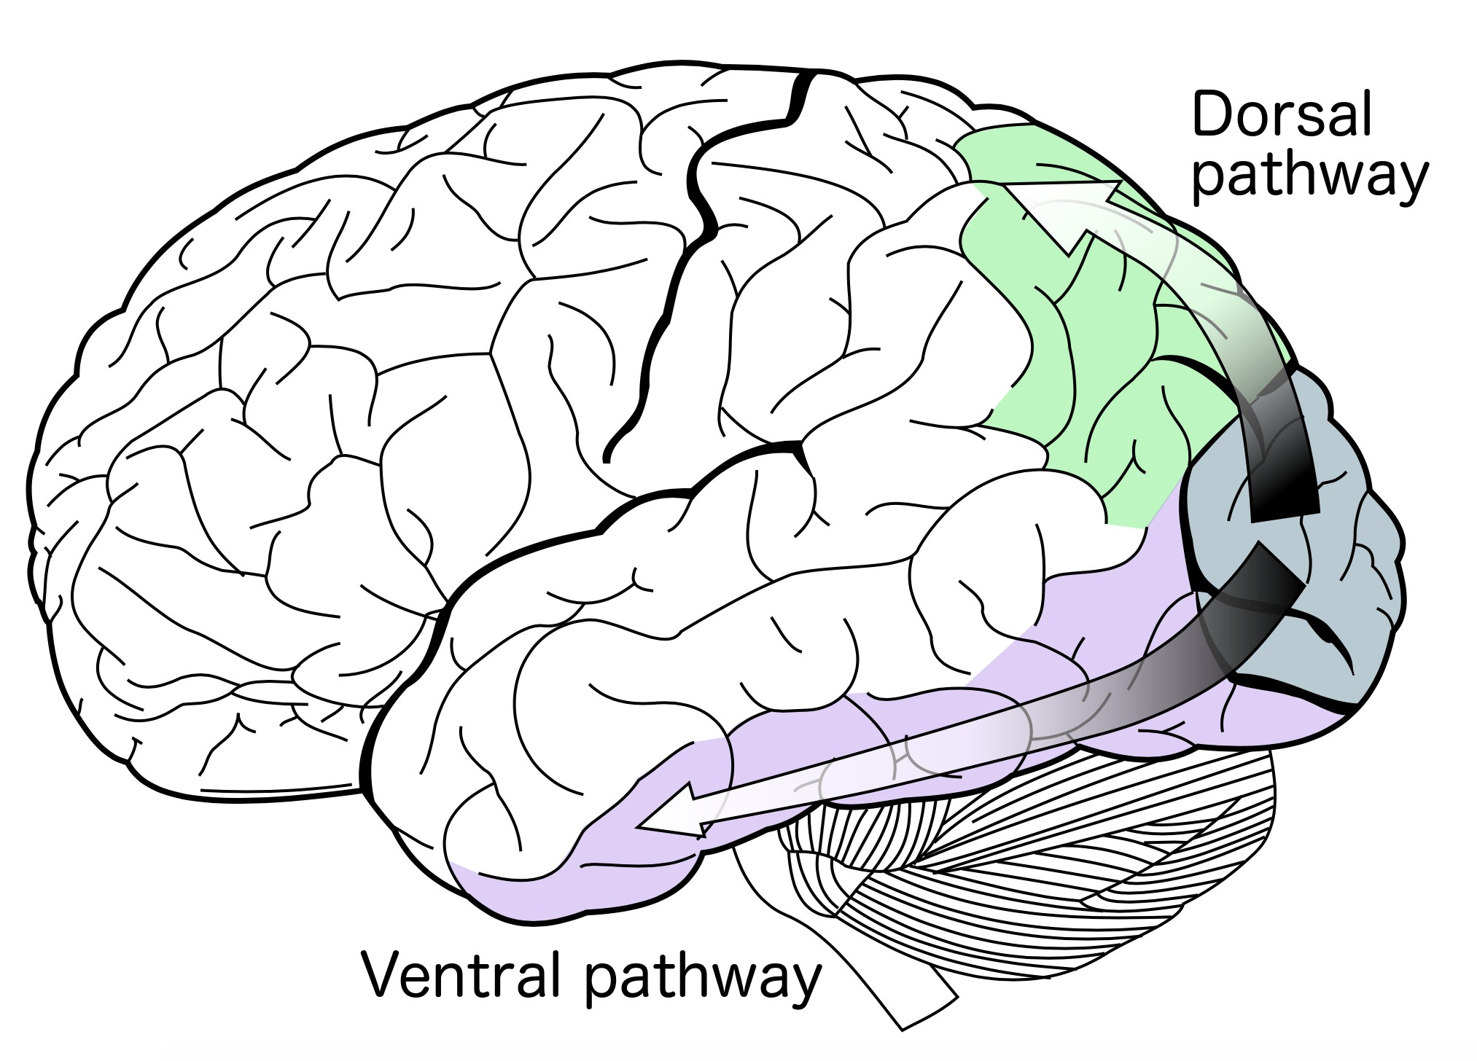
Common Visual Tasks
•
How? and what? separation
[Godale & Milner,
Trends in Neuroscience 92]
•
Visual recognition
Brain: Ventral pathway
Many visual tasks Tested in the projects
•
Vision for action
Brain: Dorsal pathway, gaze control, visuo-motor tasks, detection&tracking. Many of these tasks need robots/simulation environments
2

Slide 3
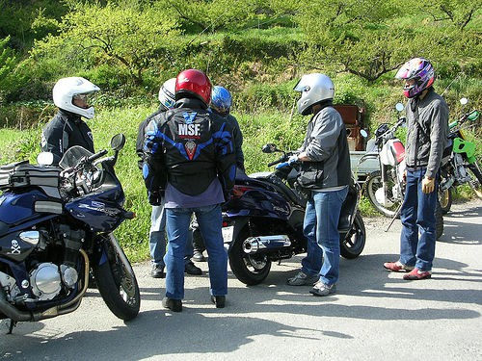
Common Visual Recognition Tasks
Image source: Pascal Context dataset
3

Slide 4
Common Visual Recognition Tasks
Captioning task (AIC):
Input:
Output:
Textual description: Bikers with motorbikes on an outdoor rural road, with trees in the background.
Image source: Pascal Context dataset

Slide 5
Common Visual Recognition Tasks
Image Classification:
Input:
Output:
Answers to a set of questions:
Is there a motorbike in this image? Is there a person in this image?
…
Yes or No?
Image source: Pascal Context dataset
5

Slide 6
Common Visual Recognition Tasks
Binary vs. Multiclass Classification:
Input:
Output:
Answers to a set of questions:
Is there a motorbike in this image? Is there a person in this image?
…
In binary classification, the questions are independent. Output is a list of probabilities: [0.7,0.8,…]
In Multiclass image classification the questions are ”Is this a …”? and the probabilities sum to 1.
Image source: Pascal Context dataset
6

Slide 7
Common Visual Recognition Tasks
Scene Categorization:
Input:
Output:
Answers to a set of questions: Is this an ”outdoor rural” scene? Is this a ”road” scene?
…
Looks at the entire image instead of details.
Image source: Pascal Context dataset
7

Slide 8
Common Visual Recognition Tasks
Object Detection:
Where are the motorbikes?
input: Image
output: Bounding boxes
Image source: Pascal Context dataset

Slide 9
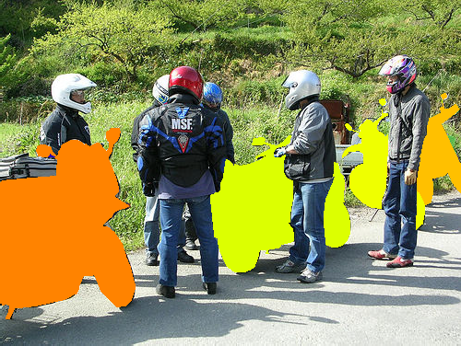
Common Visual Recognition Tasks
Object Detection/ Instance Segmentation:
Where are the motorbikes?
input: Image
output: Object masks
Image source: Pascal Context dataset
9

Slide 10
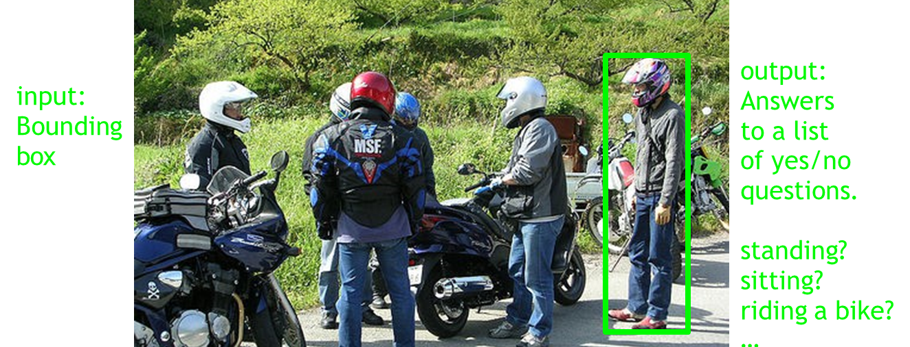
Common Visual Recognition Tasks
Activity recognition:
What is THIS person doing?

Slide 11
Common Visual Recognition Tasks
Activity recognition:
What is THIS person doing?
output: Answers to a list of yes/no questions.
input: Bounding box
Similar tasks: Facial expressions Tree speciation Clothing recognition etc.
standing? sitting? riding a bike?
…
Image source: Pascal Context dataset

Slide 12
Common Visual Recognition Tasks
Semantic Segmentation:
Tree
Tree
Tree
Tree
Person
Person
Person
Person
Motorbike
Motorbike
Motorbike
Person
Road
Road
•
If done per-pixel: semantic segmentation.
If done per-pixel: semantic segmentation.
12

Slide 13

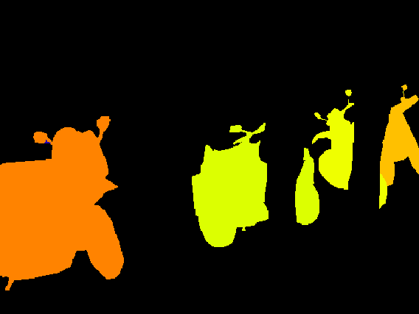
Common Visual Recognition Tasks
input image
Image source: Pascal Context dataset
Semantic segmentation
one label per class
Instance segmentation
one label per object
13

Slide 14
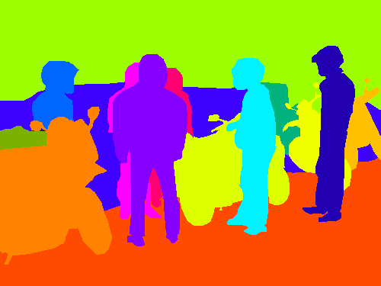
Common Visual Recognition Tasks
Panoptic segmentation:
=
Whole image is labelled, with separate labels for each object.
+
Semantic segmentation
one label per class (stuﬀ)
Instance segmentation
one label per object (things)
14

Slide 15
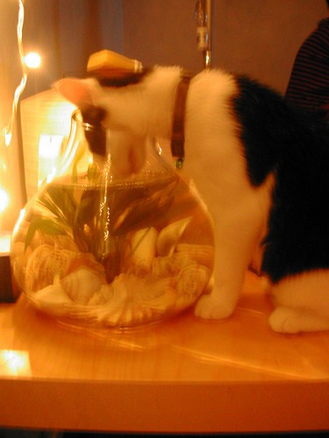
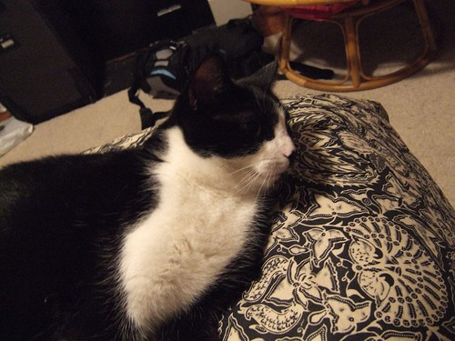
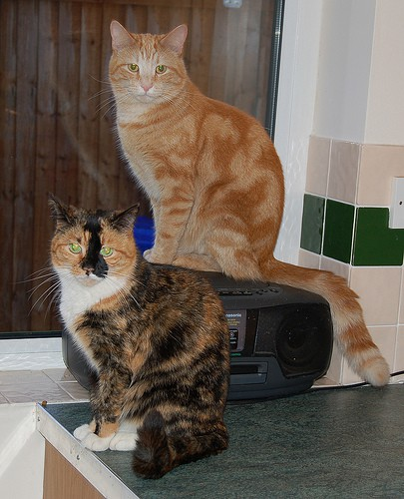
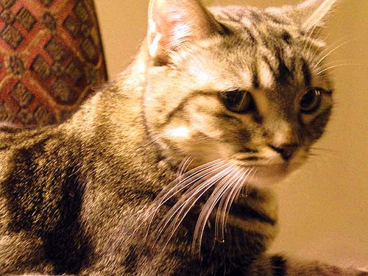
Visual Recognition
•
Object Categorization How to recognize any cat
15

Slide 16
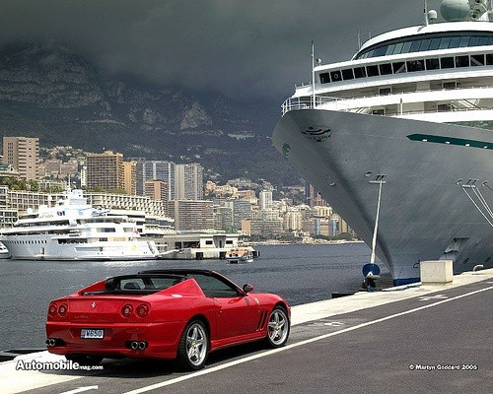
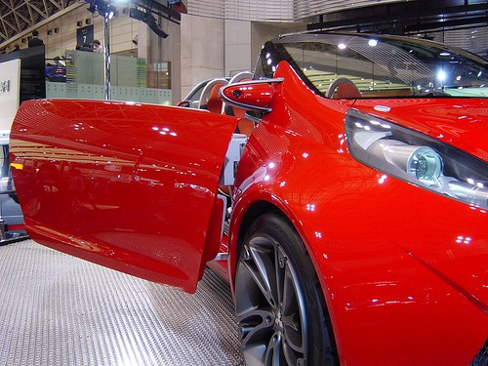
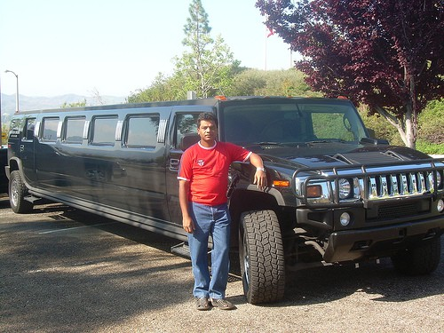
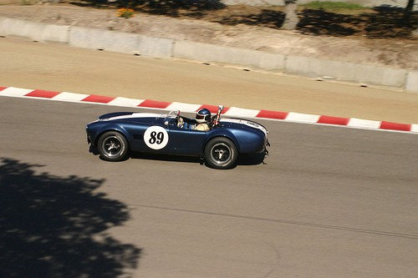
Visual Recognition
•
Object Categorization How to recognize any cat
…or how to recognize any car
16

Slide 17
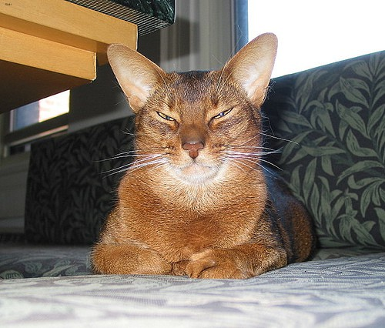
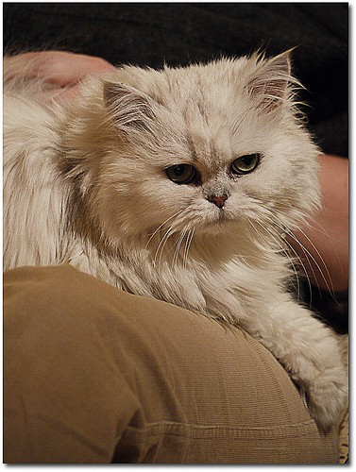
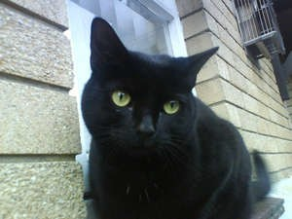
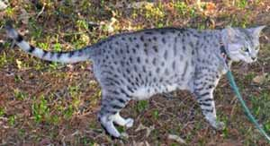
Visual Recognition
•
Object Categorization How to recognize any cat
Fine-Grained Object Categorization
How to recognize any ”Bombay cat”
17

Slide 18
Object Categorization
Problem description:
Given: A set of labelled training images
Task: Categorize a new image by predicting label probabilities.
Three key issues:
Representation: Representing an object category.
Learning: How to form a classifier (model), given training data.
Recognition: How to use the classifier on unseen test data.

Slide 19
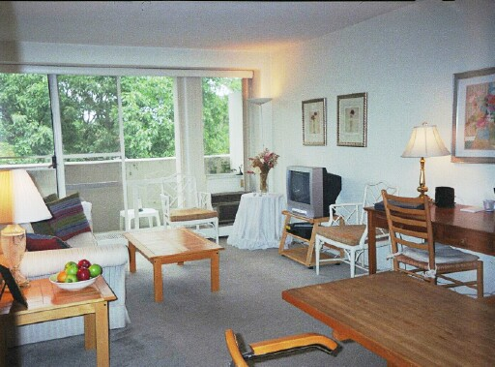

What makes object recognition diﬃcult?
Find the chair(s) in this image
Pretty much garbage
Simple template matching is not going to make it
Slide by Ali Farhadi
19

Slide 20
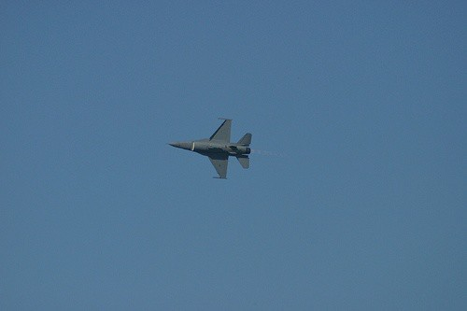
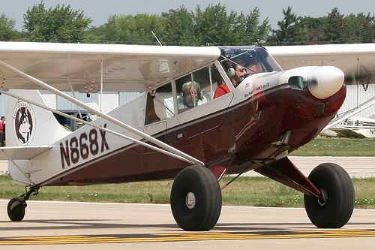
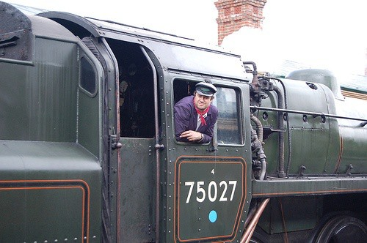
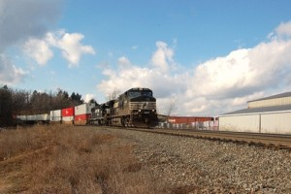
Challenges
•
Scale change
Aeroplane:
Train:
20

Slide 21
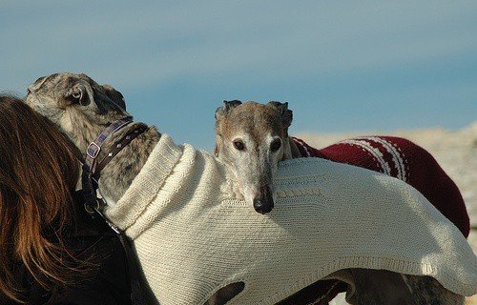
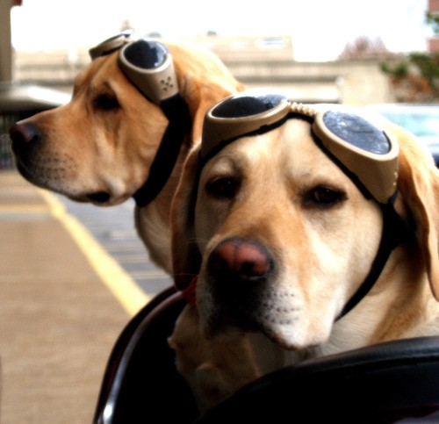
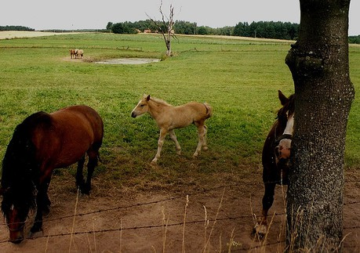
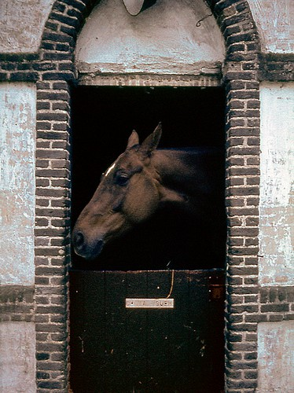
Challenges
•
Occlusion
Dog:
Horse:
21

Slide 22

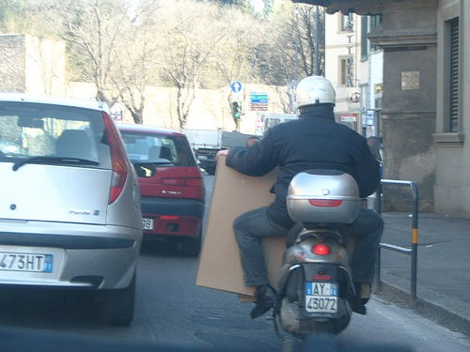
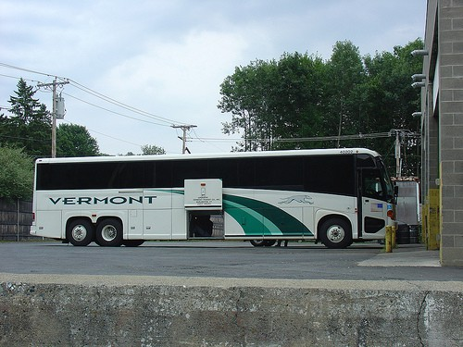
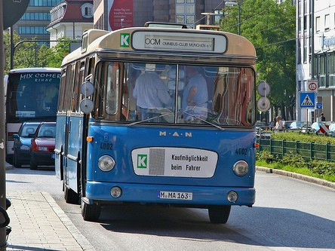
Challenges
•
Viewpoint
Person:
Bus:
22

Slide 23
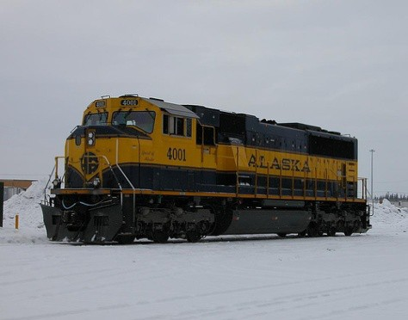
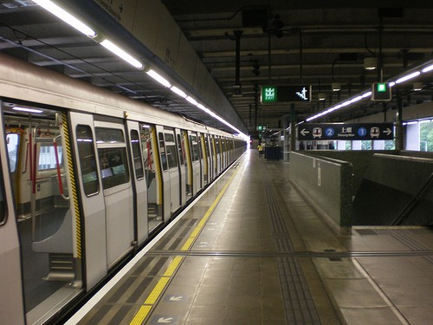
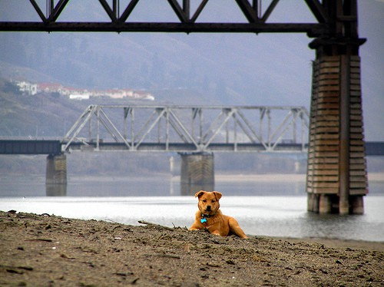
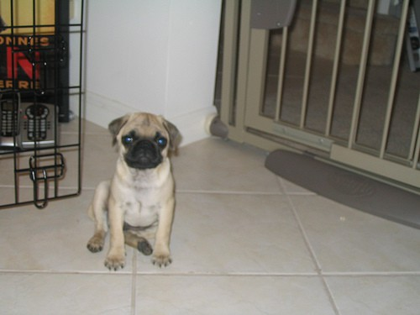
Challenges
•
Context
Train:
Dog:
23

Slide 24
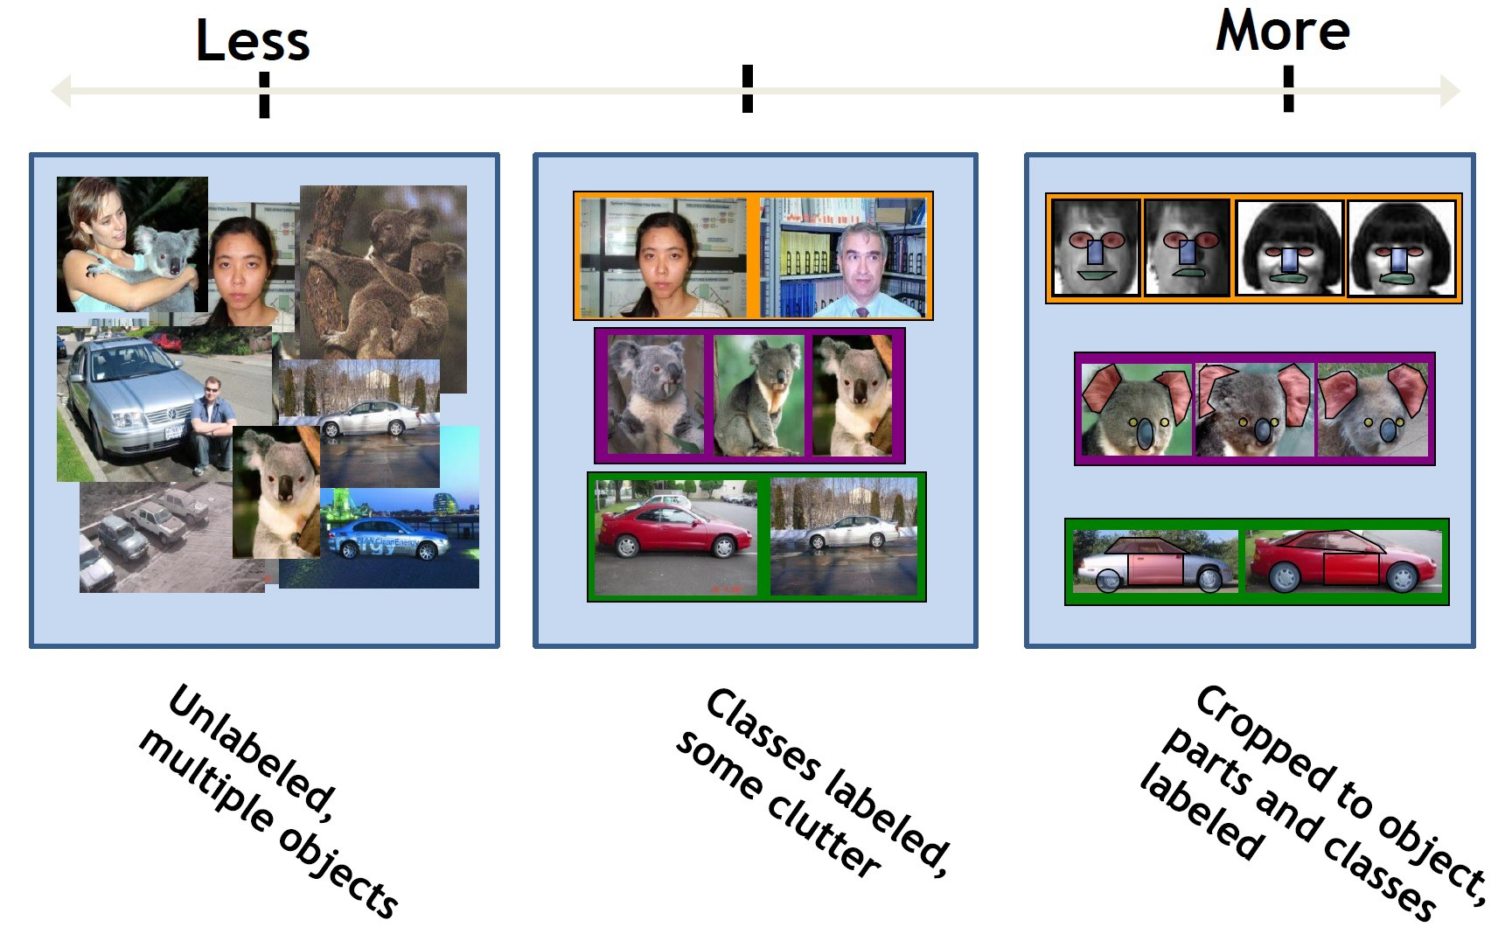
Challenges
•
Supervision Level:
Slide by Kristen Grauman

Slide 25
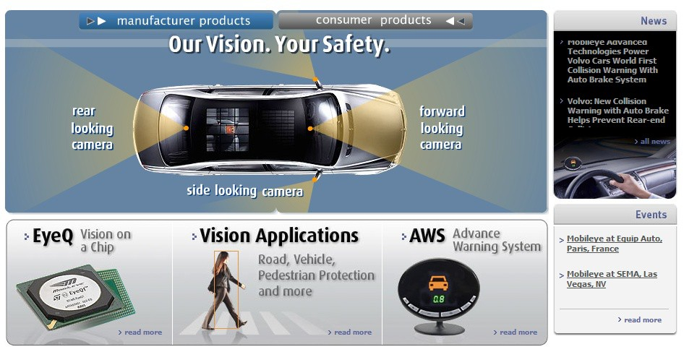
Applications of Object Recognition
Advanced Driver Assistance Systems (ADAS):
Image source: Mobileye
Company Mobileye (this image) also many others, e.g. Veoneer and Arriver in Linköping
–
–
–
–
Pedestrian collision warning Forward collision/headway warning Lane following/departure warning
Traffic signs/traffic lights/car lights recognition
25

Slide 26
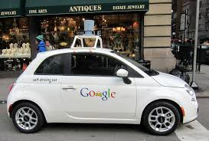
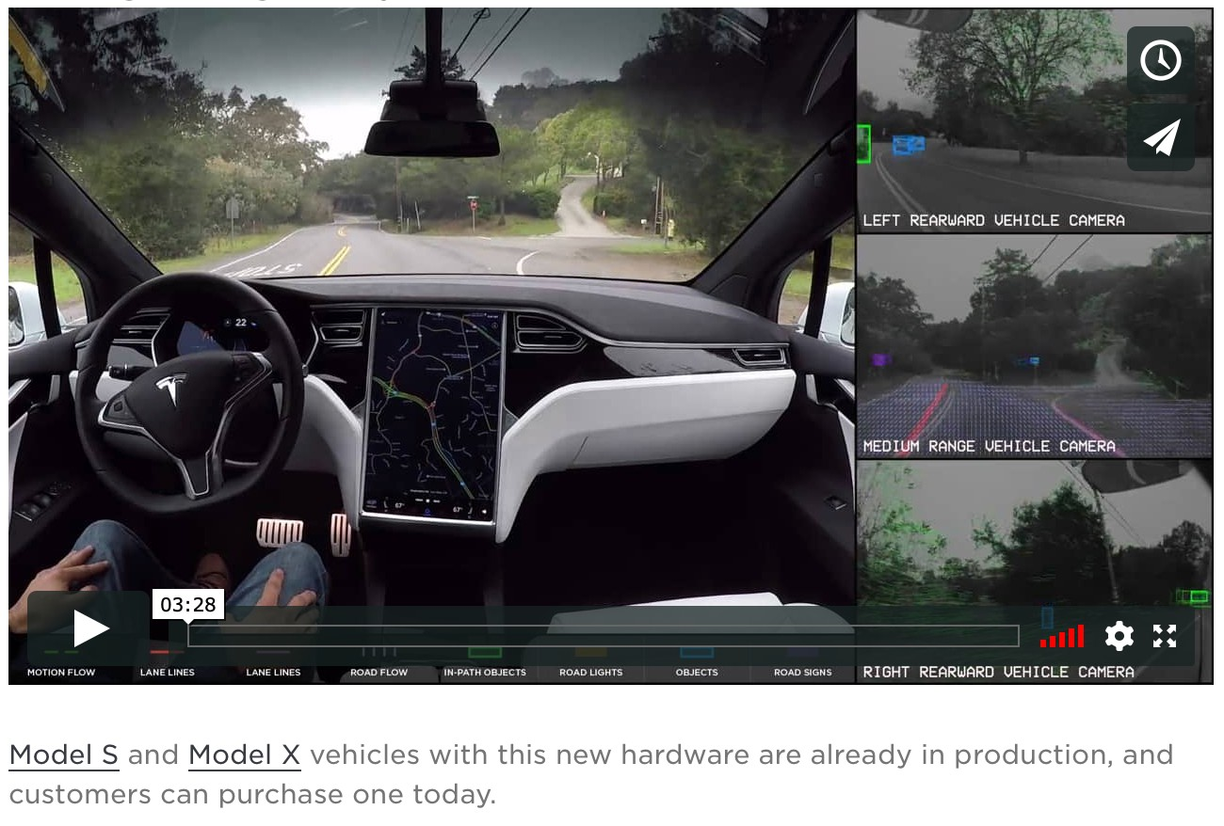
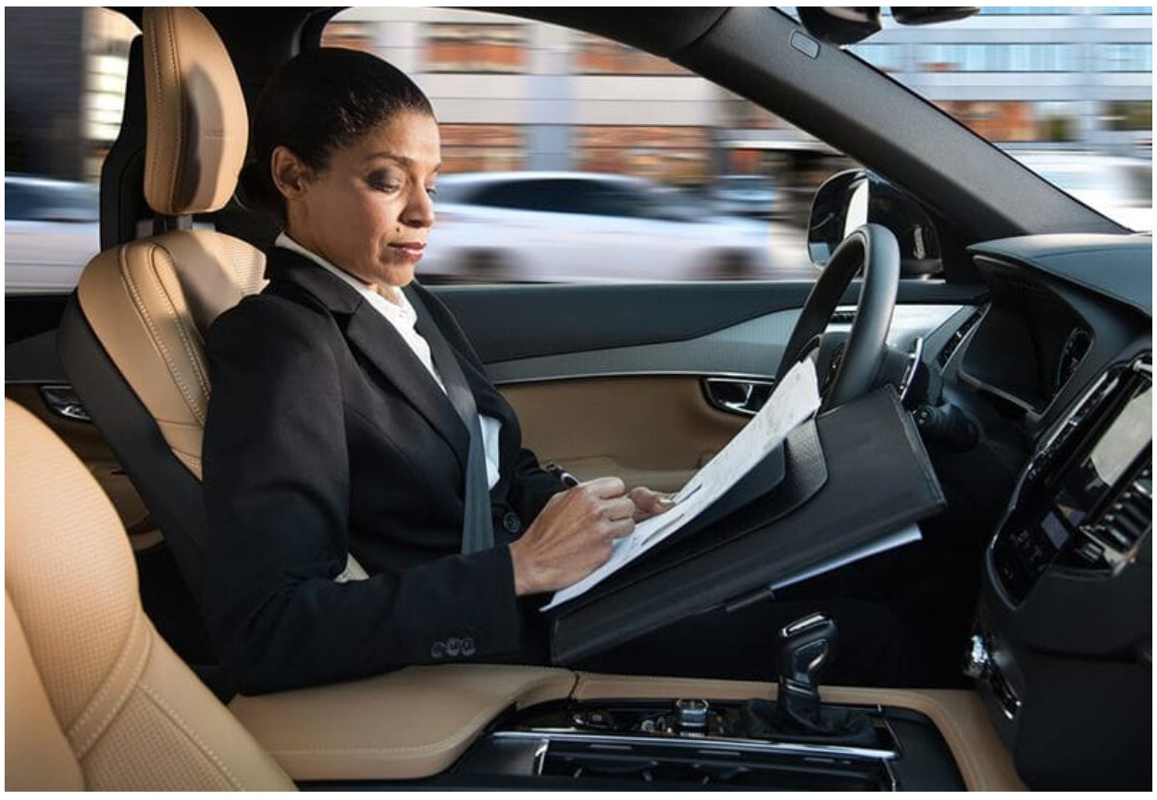
Applications of Object Recognition
Self Driving Vehicles
Waymo/Google Tesla Autopilot Volvo/Zenseact
Oct 9, 2010. "Google Cars Drive Themselves, in Traffic". The New York Times. John Markoff
June 24, 2011. "Nevada state law paves the way for driverless cars". Financial Post. Christine Dobby
Aug 9, 2011, "Human error blamed after Google's driverless car sparks five- vehicle crash". The Star (Toronto)
26

Slide 27
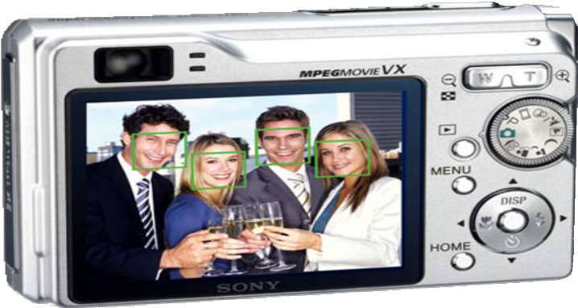
Applications of Object Recognition
Face Detection:
All cellphone cameras now have built in face and smile detection.
But this has been used in compact cameras for decades, by Canon, Sony, Fuji, …
•
27

Slide 28
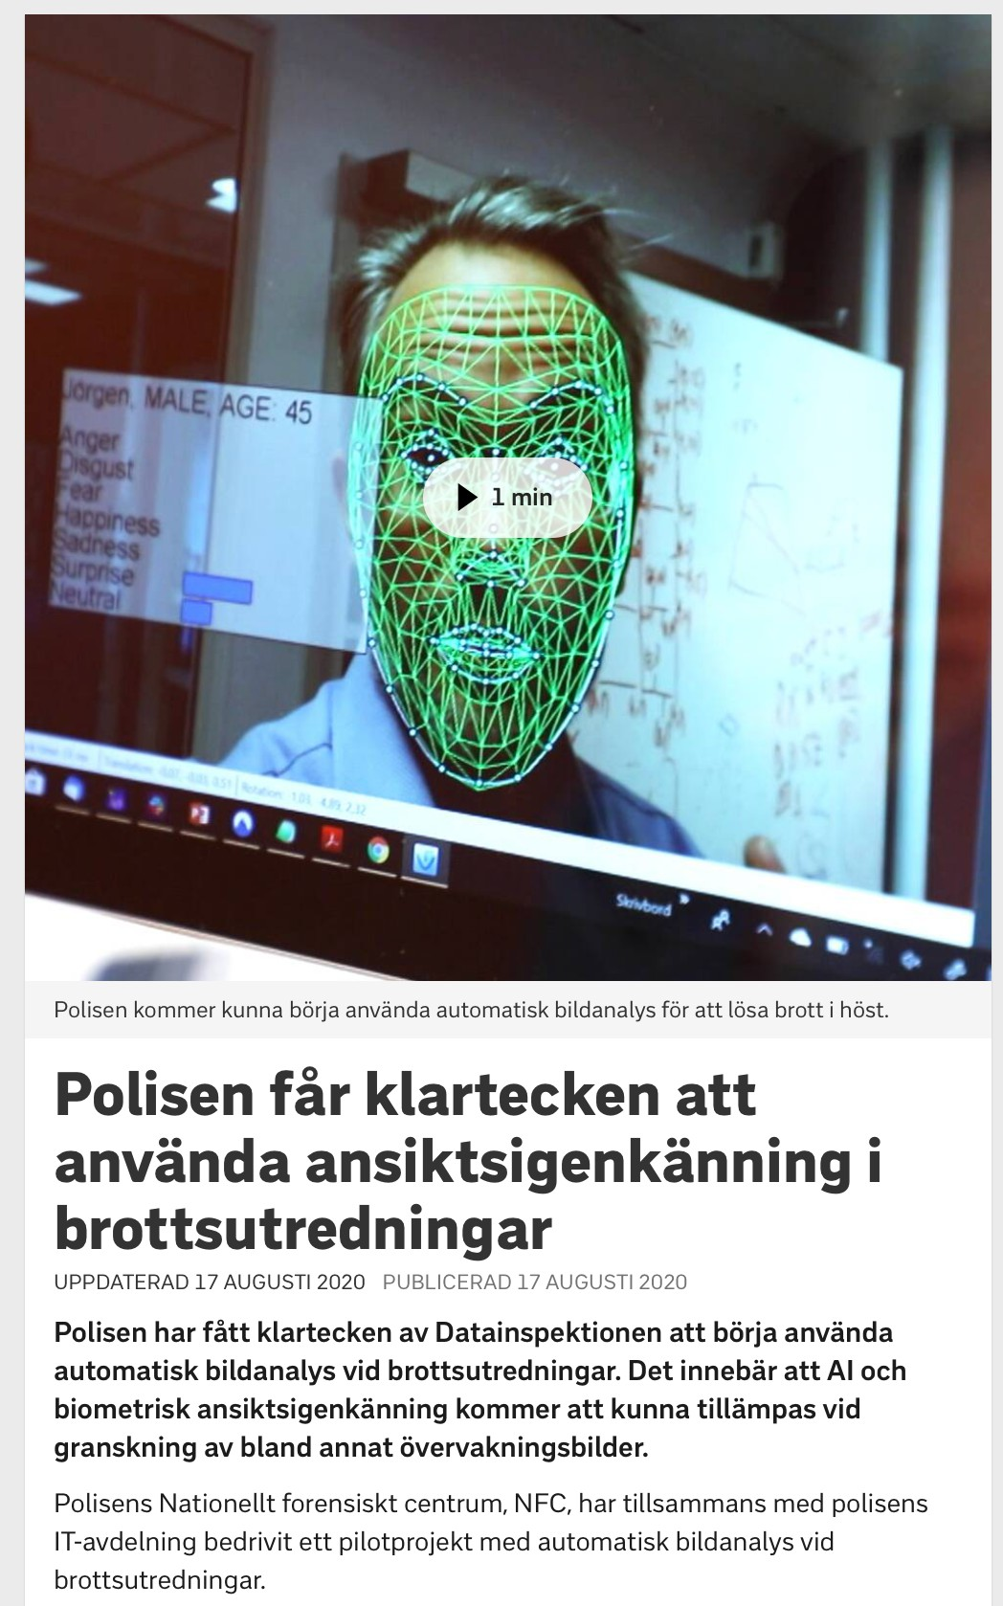
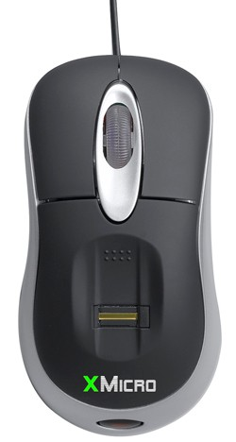
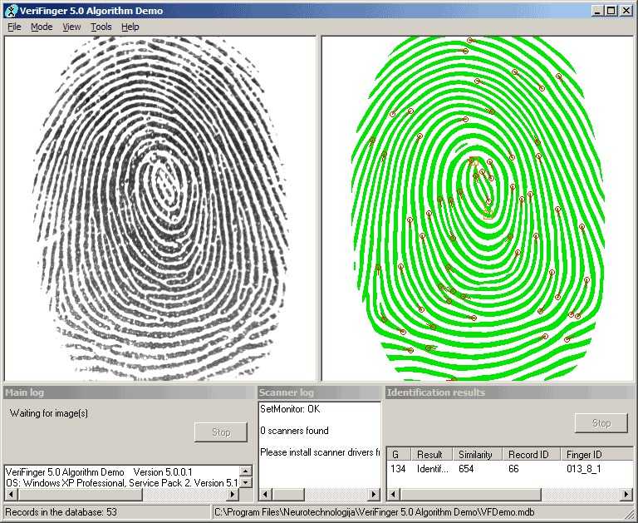
Applications of Object Recognition
Biometrics:
Fingerprint scanners on cellphones, laptops, and other devices
Face recognition systems are now being used more widely.
E.g. Apple FaceID (depth+IR)
Also forensic use by the Swedish Police.
28

Slide 29
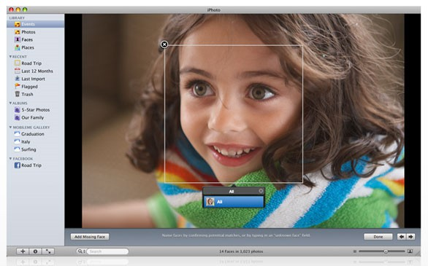
Applications of Object Recognition
Face Detection vs Face Recognition:
Illustration by Ali Farhadi
Face recognition system = detection and recognition
29

Slide 30
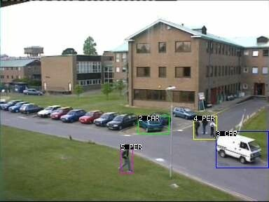
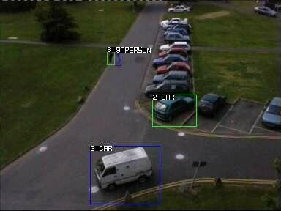
Applications of Object Recognition
Visual Surveillance and tracking (LE10):
UCF: vision lab
Can be combined with anomaly detection to alert surveillance personnel.
Can be combined with recognition for automated monitoring of citizens.
30

Slide 31
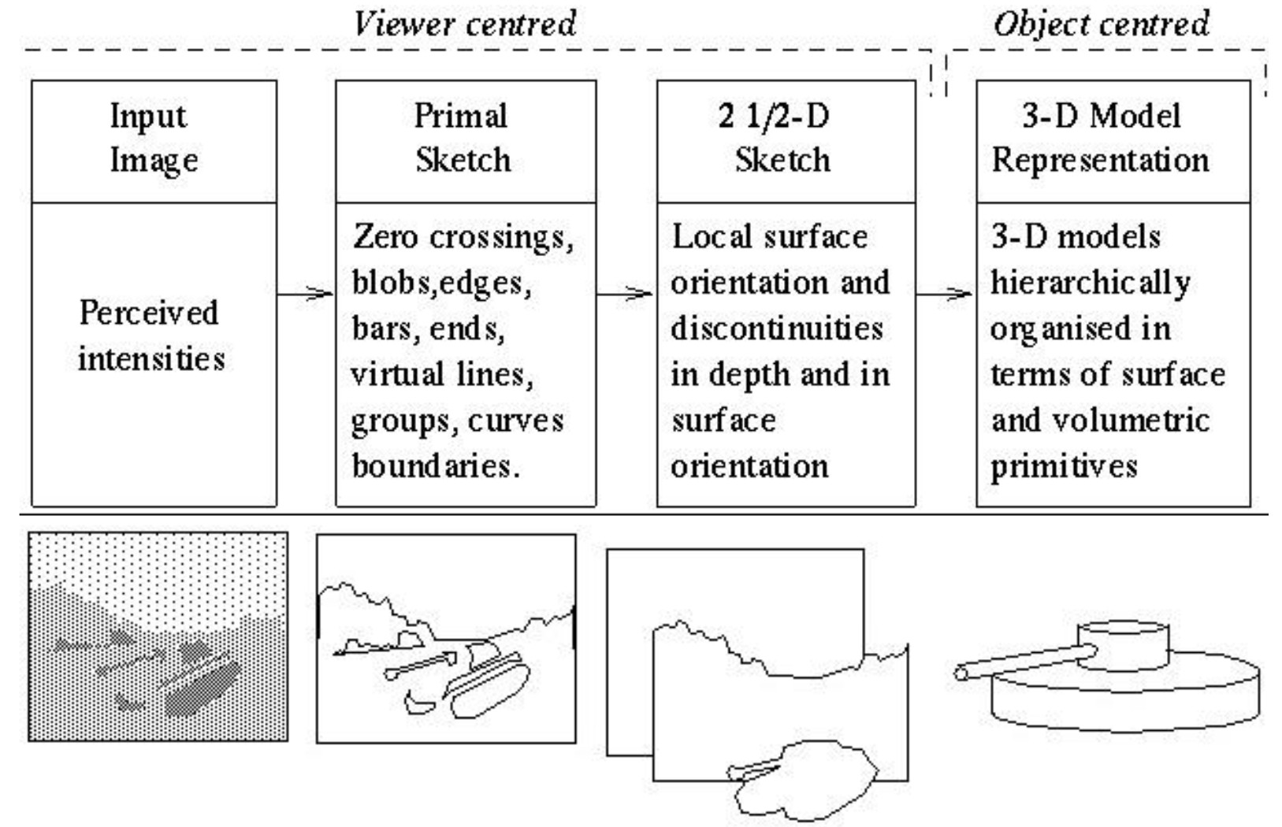
History of Ideas in Object Recognition
Marr’s Vision (Stages of Visual Representation, 1970):

Slide 32




History of Ideas in Object Recognition
…
Levels of Categorization (Rosch 1970s):
Definition of Basic Level:
Superordinate
animal
Similar shape: Basic level categories are the
…
quadruped
highest-level category for which their members have similar shapes.
Similar motor interactions: … for which people
levels
…
…
interact with its members using similar motor sequences.
Basic level
dog
cat cow
Common attributes: … there are a significant numbers of attributes in common between pairs of members.
German shepherd
Doberman
similarity
Subordinate level
…
“Fido”
…
Slide by Derek Hoiem
Sub Basic
Superordinate
32

Slide 33
History of Ideas in Object Recognition
Categories and Actions
While some categories clearly are defined by appearance attributes, a more common defining characteristic of linguistic categories is action attributes.
Chair
Table
Something you sit on.
Something to rest other objects on, and to dine at
An information processor
A device for producing music
Computer
Musical instrument Garbage
- Anything you want to throw away
..also not strictly hierarchical!
etc…

Slide 34
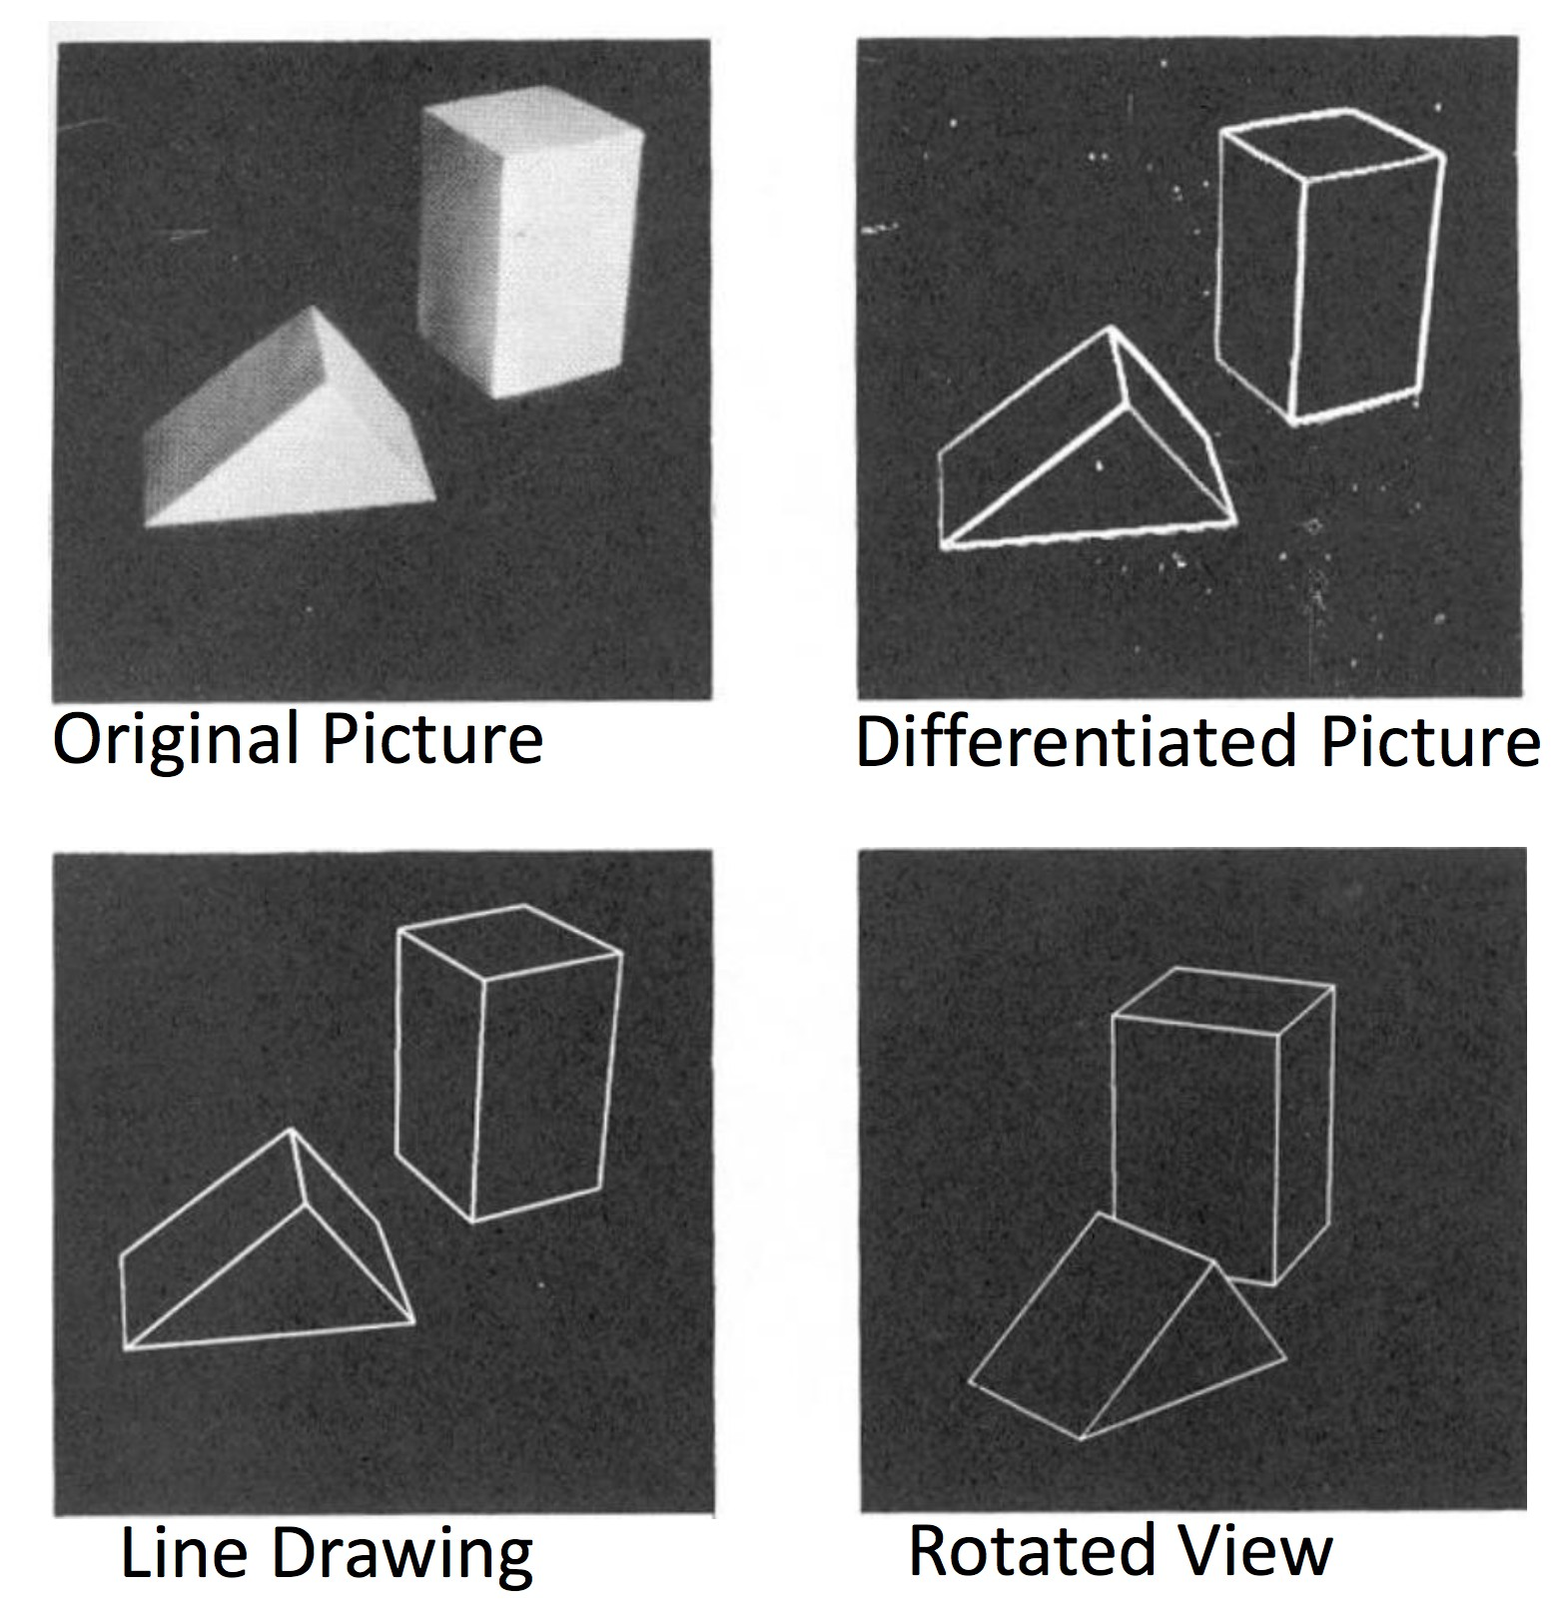
History of Inputs in Object Recognition
Inputs in 1960s:
L. G. Roberts, Machine Perception of Three Dimensional Solids, Ph.D. thesis, MIT Department of Electrical Engineering, 1963.
34

Slide 35
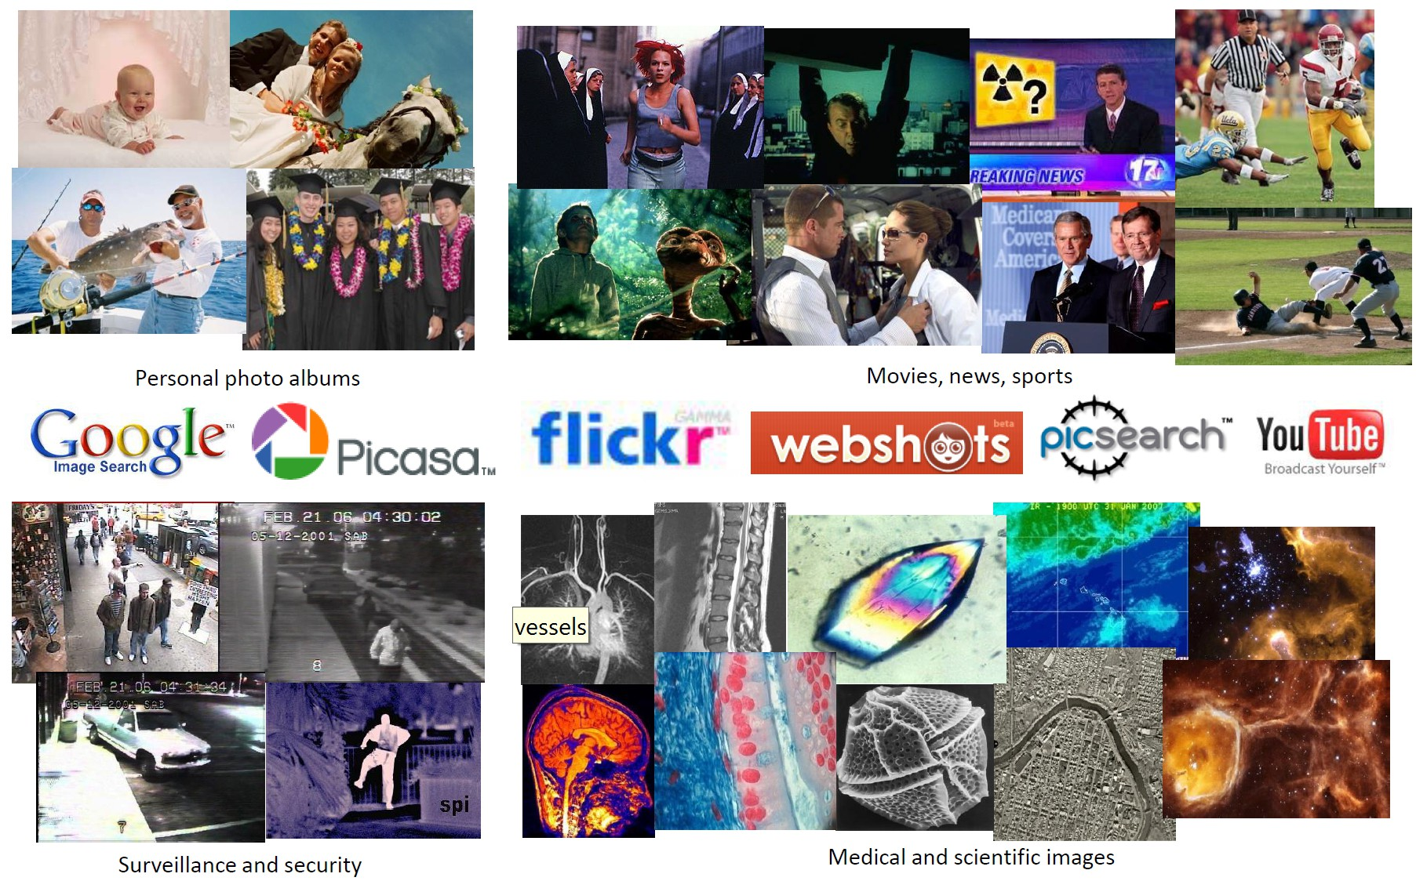
History of Inputs in Object Recognition
Inputs in more recent times:
Slide by Lazebnik
35

Slide 36
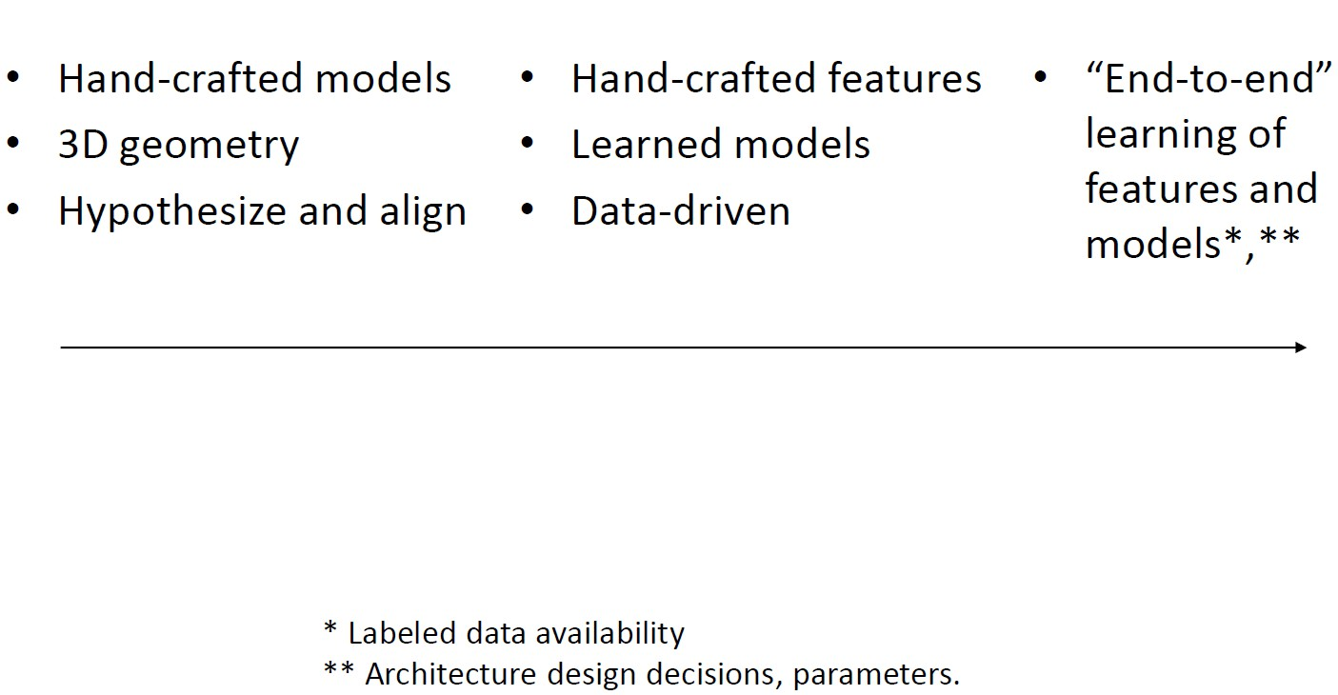
History of Ideas in Object Recognition
1960s – Early 1990s
Mid 1990s - 2012
2012 – Present
Slide by Kristen Grauman

Slide 37



Traditional Recognition Pipeline
Hand-crafted feature extraction
Image Pixels
Trainable classifier
Object Class
•
Features are designed and selected.
•
Trainable classifier is usually non-hierarchical (e.g. SVM, Random Forest, Cascaded classifier).

Slide 38





Traditional Recognition Pipeline
Training stage
Training Labels
Training Images
Feature Extraction
Classifier Training
Trained Classifier
Testing Stage
Prediction:
Outdoor
Feature Extraction
Trained Classifier
Test Image
Slide by Derek Hoiem

Slide 39



What are Good Image Features?
•
Depends on the application and what is analysed:
•
For objects:
Local shape info, shading, shadows, texture, colour.
•
For scenes:
Geometric layout, gradients, line segments, texture, colour.
•
For actions/expressions:
Local shape info, motion, optical flow, texture, colour.

Slide 40


Local and Global Image Representations
Global Representations
+ Work well for small articulations
+ Handles lower resolutions
Struggles with occlusions
Requires large training sets
Local Representations
+ Handles occlusions
+ Handles rotations and view changes
+ Handles scale variations
- Struggles with lower resolutions
Adapted from Kristen Grauman
40

Slide 41
Traditional Recognition Pipeline
Hand-crafted feature extraction
Image Pixels
Trainable classifier
Object Class
•
Object class target is [-1,1] binary classification
•
or one-hot vector [0,0,0,1,0,0] multiclass classification
•
Trainable classifier is usually non-hierarchical (e.g. SVM, Random Forest, Cascaded classifier).

Slide 42
Visual Classifiers
Learning setup: From labelled training samples, learn parameters of a scoring/decision function that is likely to predict the correct label on test samples.
Typical assumptions:
No domain shift: Training and test samples drawn from same distribution.
No label noise: Training labels are correct.

Slide 43

Visual Classifiers
•
Nearest neighbour
take a vote from K closest neighbours in training set
Can use a feature space or learn a distance measure (metric learning)
•
Learned classifiers
- score is a learned linear combination of features
e.g. SVM, perceptron, naïve Bayes, logistic regression
- Or non-linear: e.g. Mixture Model(GMM/RBF), random forest, Multi Layer Perceptron(MLP)
•
Structured prediction
first score a set of intermediate labels
E.g. labelled body part positions
Structured SVM, CNN, graphical model algorithms
Jamie Shotton, et al. CVPR 2011
43

Slide 44
Visual Classifiers
•
Popular visual classifiers in vision
-SVM: linear, fast training/classification; performs well with lots of weak features
Logistic Regression: outputs a probability; easy to train and apply
K-Nearest Neighbour: very good if there is tons of data (e.g., character recognition)
Boosted stumps or decision trees: applies to flexible features, incorporates feature selection, powerful classifiers
Random forests: use multiple decision trees to output probability; good for simple features, tons of data, parallel training, runtime speed
Deep networks / CNNs: flexible output; learns features; adapt existing network (which is trained with tons of data) or train new with tons of data

Slide 45
History of Ideas in Object Recognition
1960s – Early 1990s
Mid 1990s - 2012
2012 – Present
Slide by Kristen Grauman

Slide 46
Deep Learning
Idea: Learning image features and classifiers that work jointly (end-to-end training).
•
•
2012 ImageNet Challenge: Large-scale image classification
Method | Top-5 Error | Method Description
SuperVision (Toronto) | 0.16422 | CNN
ISI (Tokyo) | 0.26172 | Hand-crafted features: SIFT, HOG and LBP
OXFORD | 0.26979 | DPM + Hand-crafted features
XRCE/INRIA | 0.27058 | Hand-crafted features

Slide 47

Deep Learning
•
Key Ingredients
Very large annotated datasets
Large computational resources (GPUs)
•
ImageNet Large Scale Visual Recognition Challenge [Deng et al. 2009]
•
ILSVRC 2017
more than 14 million images
more than 10 million images annotated
more than 1 million images with bounding box
•
Classification error rate 2011: 26%
•
Using CNNs in 2012: 16% (Now <3%)
Table by: Gustav von Zitzewitz
47

Slide 48

Modern Recognition Datasets
48

Slide 49
Summary
•
Visual Recognition has many subproblems, categorization, detection, recognition.
•
Until 2012 feature extraction and classification were separate stages, now they can be learned jointly (end-to end).
•
End-to-end learning requires huge amounts of data and computational resources.
49

